Slide 1
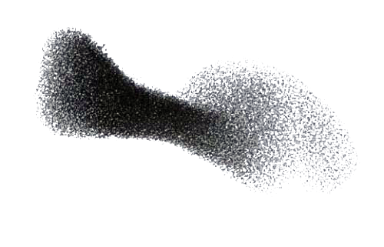
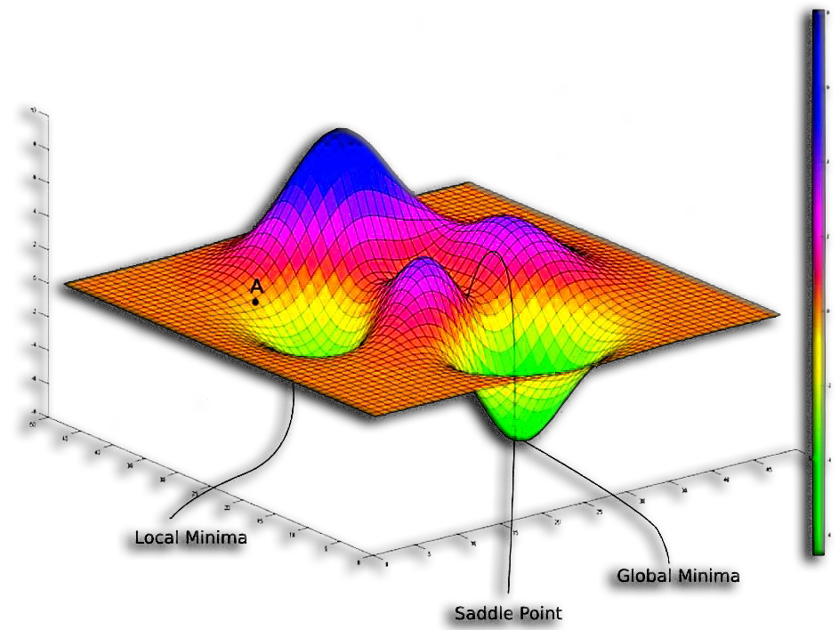
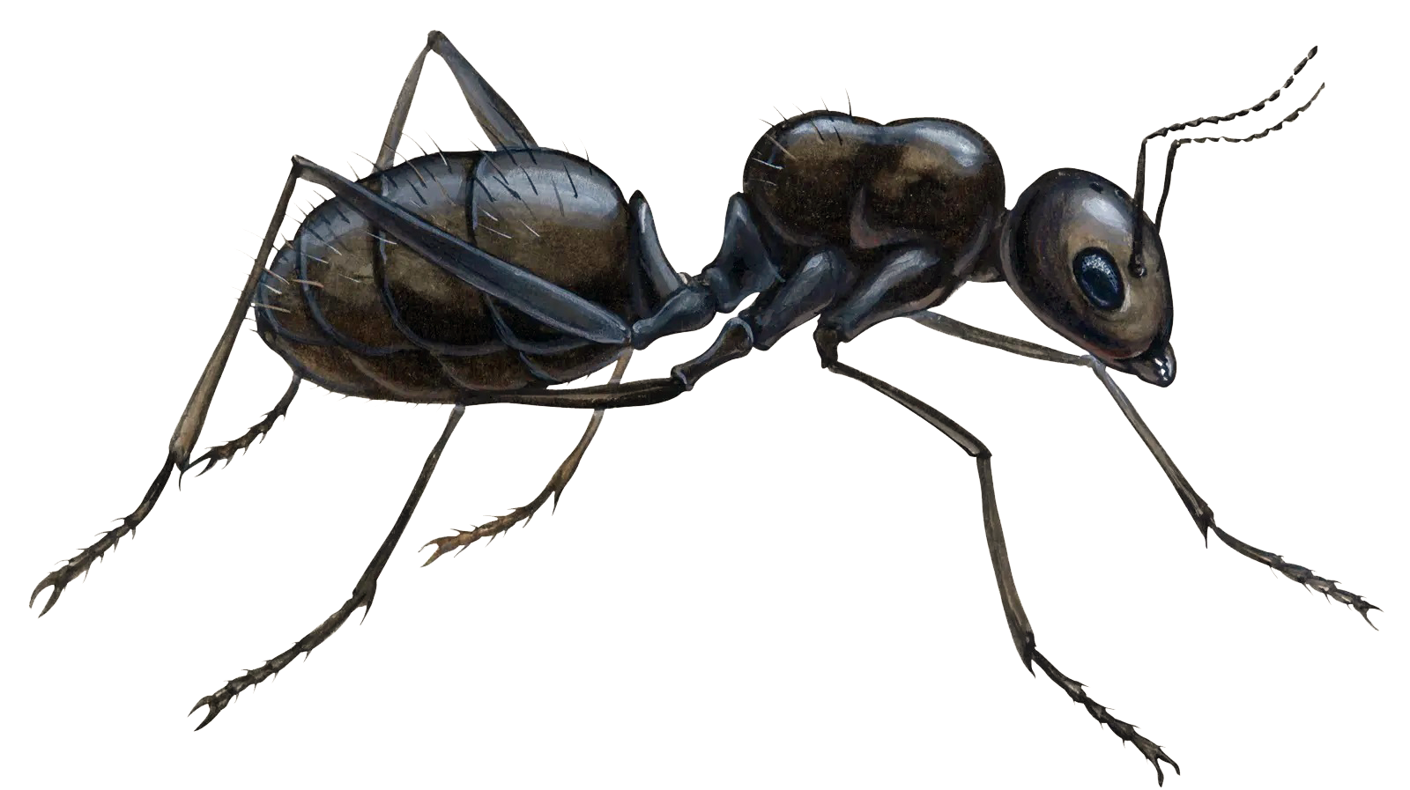
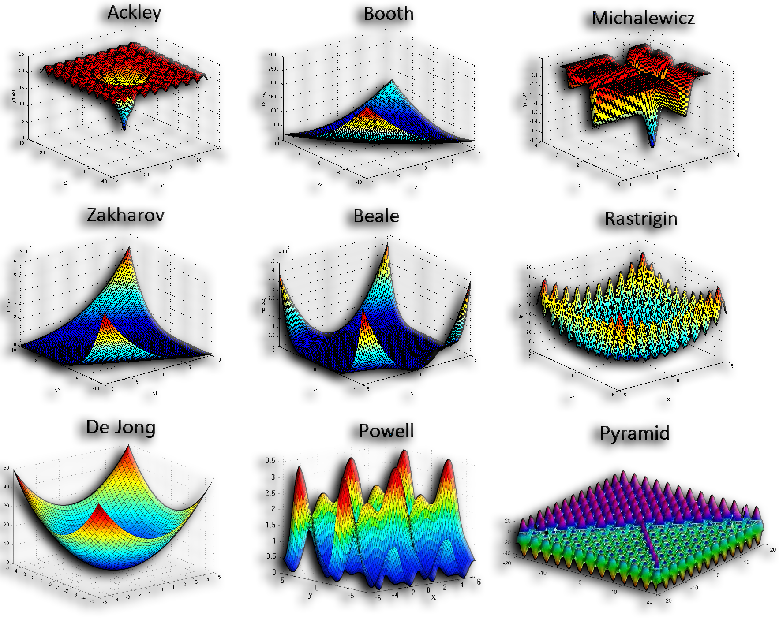


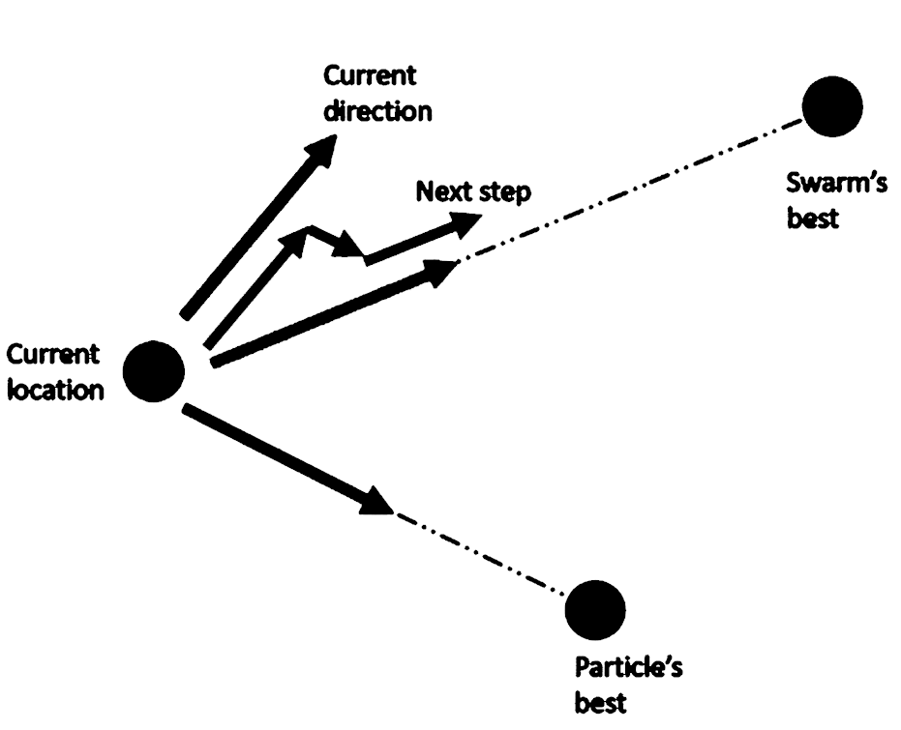
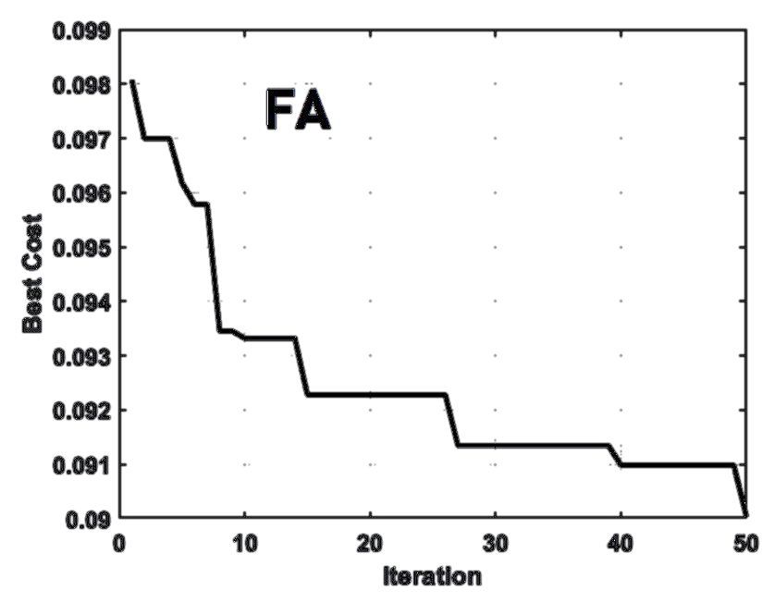

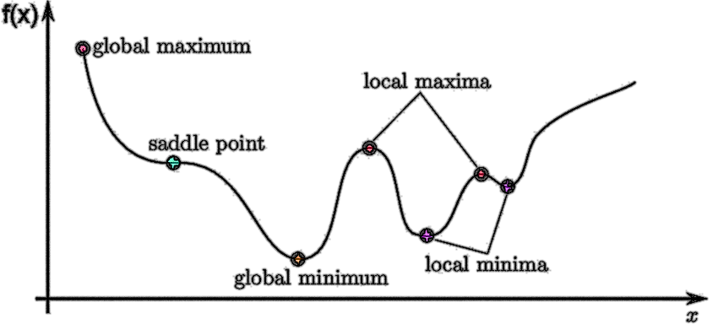

Metaheuristic Optimization: 4 Cutting-Edge Applications
Protein Structure Prediction by Differential Evolution algorithm (DE)
By: Seyed Muhammad Hossein Mousavi
2025

Slide 2


Outline:
Optimization
Optimization Problems
Protein Structure Prediction (Protein Folding) by Differential Evolution algorithm (DE)
Space-Time Warping by Firefly Algorithm (FA)
Exoplanetary Adaptation Simulation by Genetic Algorithm (GA)
Evolved Antenna Design by Particle Swarm Optimization algorithm (PSO)

Slide 3

Optimization Problems
Protein Folding by Differential Evolution algorithm (DE)
Amino acids are the basic building blocks of proteins, linked together in chains.
A protein is a large biomolecule made of amino acids that performs vital functions in living organisms.
A peptide bond is the chemical link between two amino acids in a protein chain.
Protein folding is the process by which a linear chain of amino acids folds into a functional 3D shape.
Protein structure refers to the 3D arrangement of atoms in a protein, determining its function.
Protein energy minimization is the process of finding the most stable shape of a protein by minimizing its total energy.
Why is protein folding important?
Protein folding is essential in nature because only the correctly folded shape allows a protein to perform its biological function inside living cells.
In case of misfolding diseases such as Alzheimer’s, Parkinson and more appear.
To simulate folding in the lab to understand, predict, fix, or design new proteins to find cures to diseases.

Slide 4
Optimization Problems
Protein Folding by Differential Evolution algorithm (DE)
This section helps to understand how a protein folds.
Useful for identifying when it folds incorrectly.
Detecting misfolded shapes, related to diseases like Alzheimer’s, Parkinson’s, and more.
We minimize the total energy of the protein, which includes:
Lennard-Jones potential (for non-bonded/adjacent amino acids) and
Harmonic bond energy (for adjacent amino acids)
By adjusting the 3D positions of amino acids so that distances between them are physically ideal:
Not too close (causing strong repulsion (high energy)) and
Not too far (breaking bonds (high energy)),
We use Differential Evolution (DE) to search for the most stable, lowest-energy arrangement.
By finding not far nor close but just the right distance.
We are looking for the distance from one amino acid to another in 3D space.
Each amino acid has a 3D coordinate (x, y, z)
The code calculates the distance between pairs of these coordinates.

Slide 5
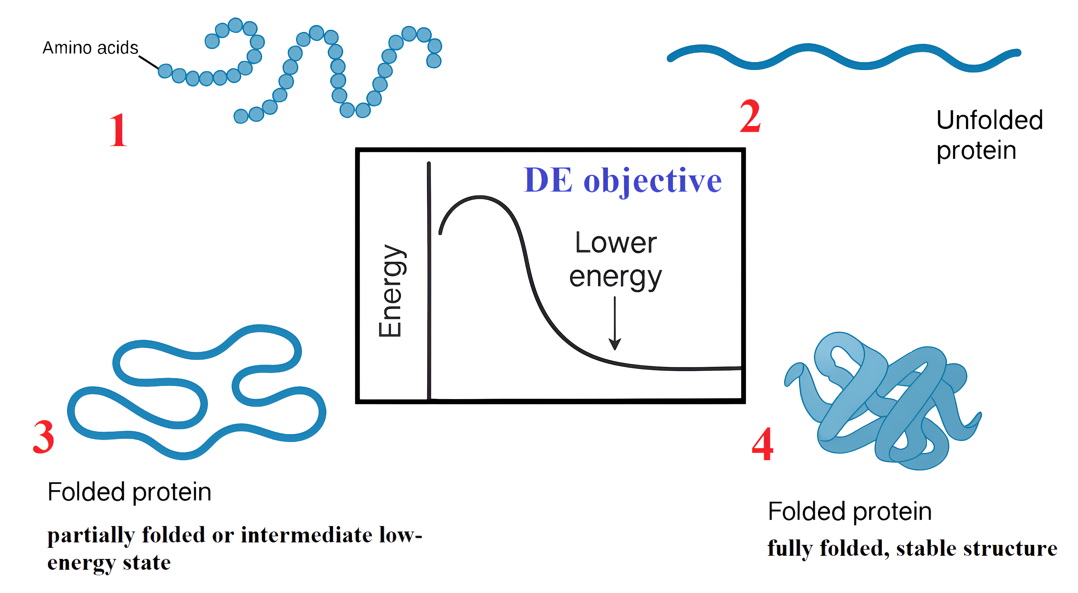
Optimization Problems
Protein Folding by Differential Evolution algorithm (DE)
Differential Evolution (DE) is used because it’s a powerful optimization algorithm that works well on complex, non-linear problems like protein folding.
Its advantage is that it doesn’t need gradients and can efficiently explore the search space to find a global minimum even in rugged energy landscapes.

Slide 6
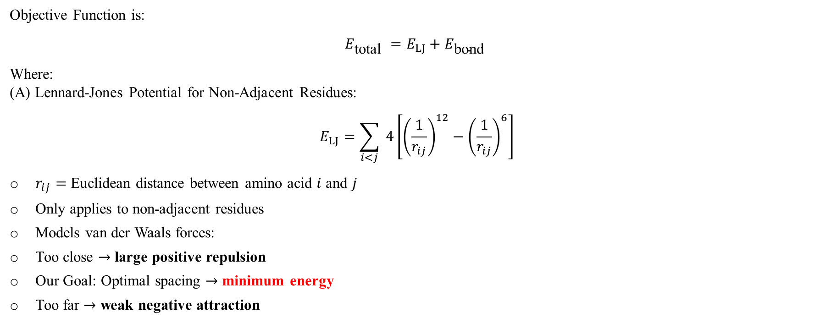
Optimization Problems
Protein Folding by Differential Evolution algorithm (DE)
Objective Function is:
$$E_{\text{total} }=E_{LJ}+E_{\text{bond} }$$
Where: (A) Lennard-Jones Potential for Non-Adjacent Residues:
$$E_{LJ}=\sum_{i<j}{ }4\left[{\left(\frac{1}{r_{ij}}\right)}^{12}−{\left(\frac{1}{r_{ij}}\right)}^{6}\right]$$
$r_{ij}=$ Euclidean distance between amino acid $i$ and $j$
Only applies to non-adjacent residues
Models van der Waals forces:
Too close $→$ large positive repulsion
Our Goal: Optimal spacing $→$ minimum energy
Too far $→$ weak negative attraction

Slide 7
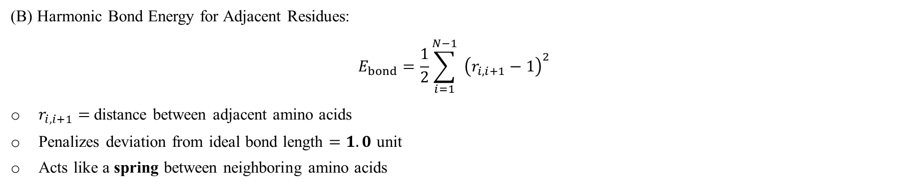
Optimization Problems
Protein Folding by Differential Evolution algorithm (DE)
(B) Harmonic Bond Energy for Adjacent Residues:
$$E_{bond}=\frac{1}{2}\sum_{i=1}^{N−1}{ }{\left(r_{i,i+1}−1\right)}^{2}$$
$r_{i,i+1}=$ distance between adjacent amino acids
Penalizes deviation from ideal bond length $=1.0$ unit
Acts like a spring between neighboring amino acids

Slide 8
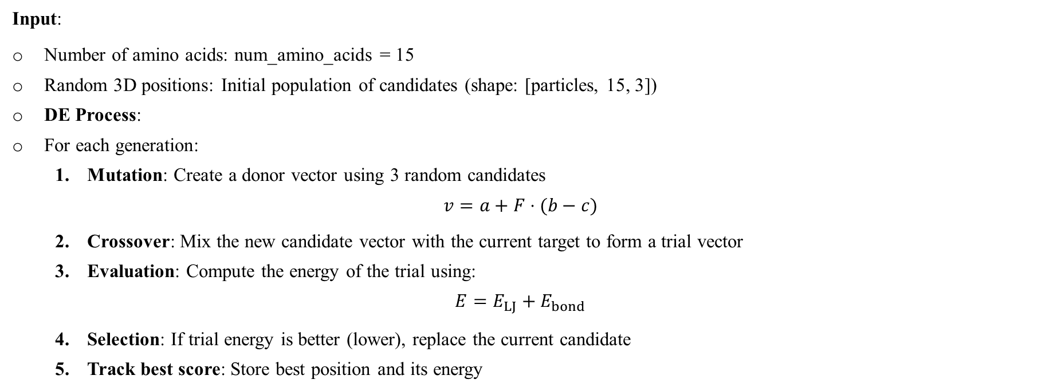
Optimization Problems
Protein Folding by Differential Evolution algorithm (DE)
Input:
Number of amino acids: num_amino_acids = 15
Random 3D positions: Initial population of candidates (shape: [particles, 15, 3])
DE Process:
For each generation:
Mutation: Create a donor vector using 3 random candidates
$$v=a+F⋅(b−c)$$
Crossover: Mix the new candidate vector with the current target to form a trial vector
Evaluation: Compute the energy of the trial using:
$$E=E_{LJ}+E_{bond}$$
Selection: If trial energy is better (lower), replace the current candidate
Track best score: Store best position and its energy

Slide 9
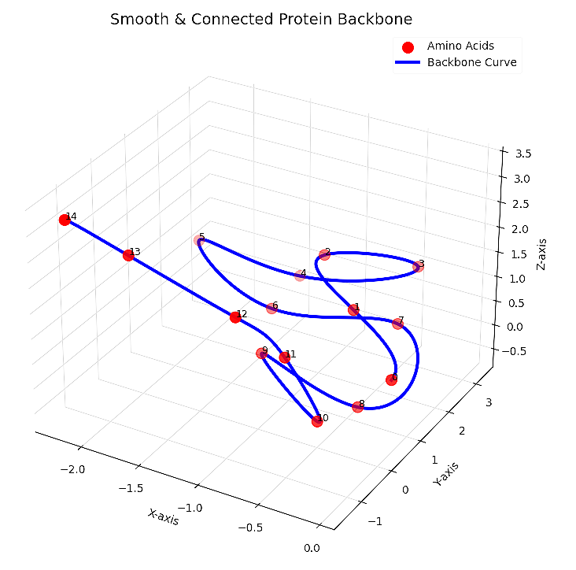
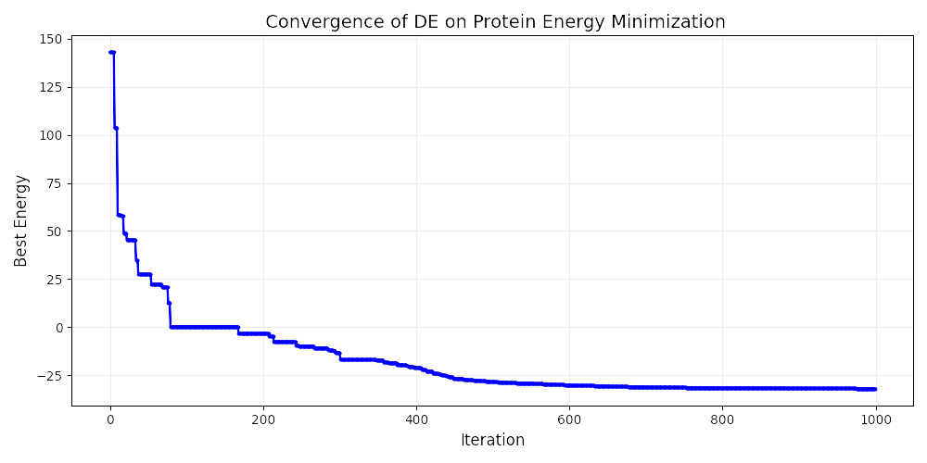
Optimization Problems
Protein Folding by Differential Evolution algorithm (DE)
Output:
Best 3D positions of all 15 amino acids
Final minimized energy
Convergence plot showing energy decreasing over iterations
3D visualization of the final folded protein structure

